Slide 1
Front End Engineering-I
Project
Name : Rakshit Kaushal(2110991941)
Faculty Coordinator: MR. L a v i s h A r o r a
:
Chitkara University Institute of Engineering and Technology, Chitkara University, Punjab

Slide 2
Wordplay Books

Slide 3


Table of Contents
Introduction
Technical Details
Key Features
Project Highlights
Conclusion
References/Links used

Slide 4

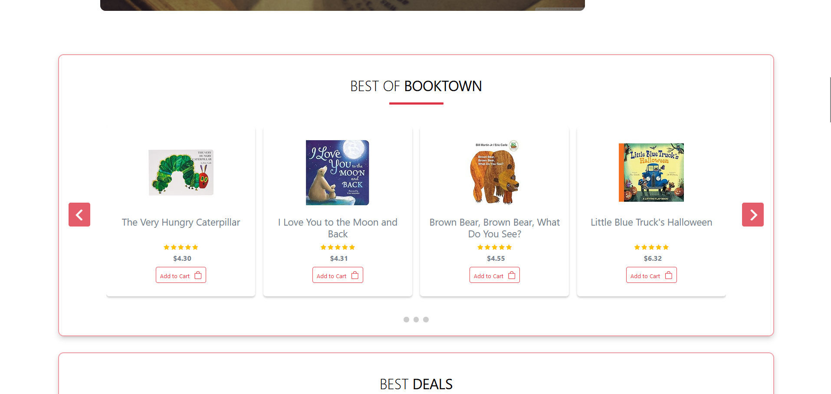
Introduction
Welcome to Wordplay Books,
where words come alive! In this presentation, we will explore the fascinating world of wordplay in literature, learn why it's important, and discover popular books that showcase its creativity
Wordplay is the clever and creative use of words to create humor, convey deeper meaning, or engage the reader's imagination. Explore different types of wordplay and how they can elevate your own writing.

Slide 5
Technical Details
HTML is the standard markup language used to create web pages. It is essential to ensure that the HTML code is clean and valid, including using proper headings, meta tags, and structured data. This helps search engines understand the content of the web pages and index them properly.
CSS is used to style the web page and make it visually appealing to users. While CSS does not have a direct impact on SEO, it can indirectly affect the user experience. A well-designed website that is visually appealing and easy to navigate can improves the user experience
JavaScript is a programming language used to add interactivity and dynamic content to web pages. It can be used to create animations, pop-ups, and other interactive elements that can enhance the user experience.
A responsive design that works well on different screen sizes and devices is essential for SEO as mobile traffic continues to increase.
A fast loading website is crucial for SEO. You can improve page speed by optimizing images, minifying code, and leveraging caching.
A well-structured URL that includes the target keyword can help search engines understand the
content of the page.
jQuery is a lightweight JavaScript library. It's sole purpose is to make it much easier to use
Javascript on your website.
Linking to other relevant pages on your site can help search engines understand the context of your content and improve the user experience.

Slide 6
Key Features
1. 100+ books
2. All Books Available
3.Easy ordering
4.Easy Cancellation
5.Discount Offer/coupons
6. Books Issuing

Slide 7
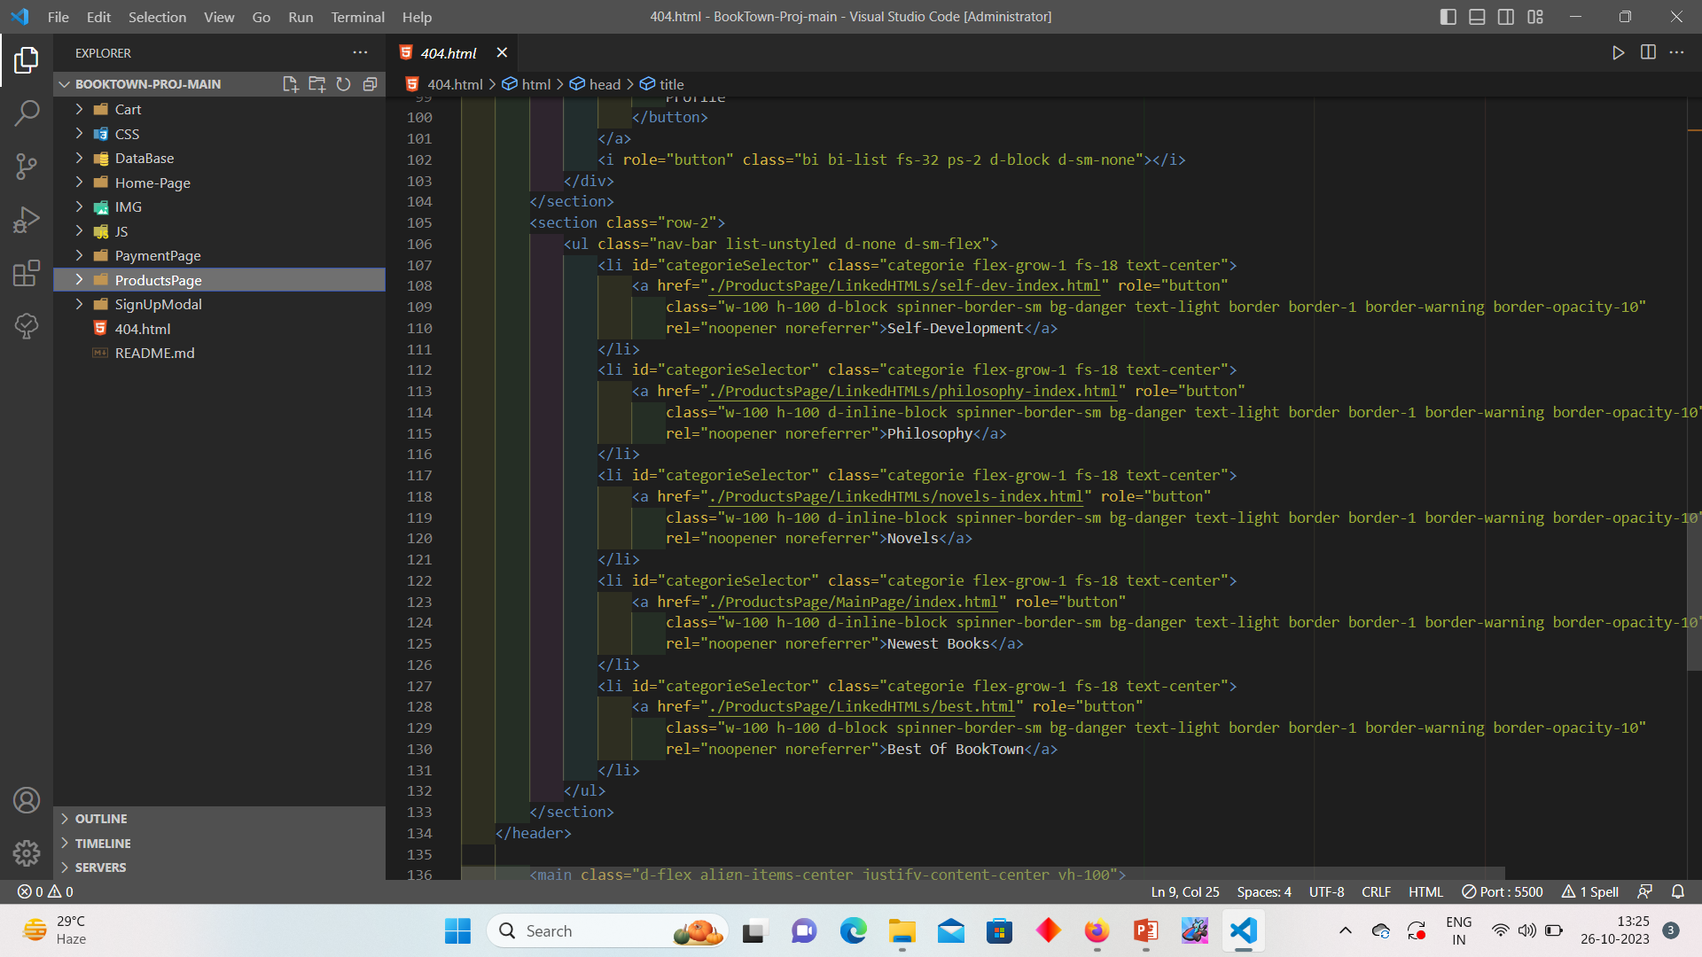
Code Highlight

Slide 8
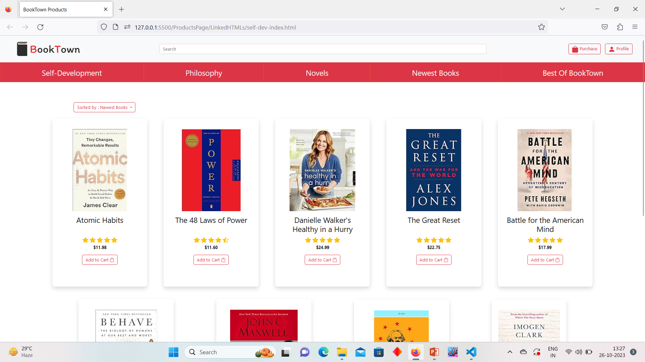
Project Highlights

Slide 9
Conclusion
Dive into the World of Wordplay
Incorporating wordplay into your writing opens up a realm of endless fun and creativity. Start exploring and let the power of words take you on a remarkable journey!
Recommended Resources:
"The Ode Less Traveled" by Stephen Fry
"I Is an Other: The Secret Life of Metaphor and How It Shapes the Way We See the World" by James Geary
"The Pun Also Rises: How the Humble Pun Revolutionized Language, Changed History, and Made Wordplay More Than Some Antics" by John Pollack

Slide 10
References/Links use
The link used is:-
https://www.w3schools.com/
https://stackoverflow.com/
https://www.geeksforgeeks.org/
HTML and CSS: Design and Build Websites
Learning Web Design: A Beginner's Guide to HTML, CSS, JavaScript, and Web Graphics

Slide 11


